Slide 1
Penta Hack! Fun with AI Geometry
By: Ee Sheng, Derrick
Next
Notes:
https://dev.azure.com/NanyangPoly/FYPJ_AutoMalwareAnalysisUsingSandboxTech

Slide 2
Problem Statement
How to integrate AI with education?
Back
Next

Slide 3
Challenges
Traditional classroom environments and materials can be boring and unengaging for learners, especially younger children
Lack of engagement can lead to disinterest in learning and poor academic performance
Therefore, there is a need for more innovative and interactive approaches to education that make learning more fun and engaging
Challenges faced in engaging different age groups
For example, children may prefer hands-on activities and games, while teenagers may prefer self-directed learning and real-world applications of what they learn
Back
Next

Slide 4
Solution: Fun with AI Geometry
Fun with AI Geometry is a web-based graphical user interface that helps learners of all ages engage with mathematical concepts in a fun and interactive way
By drawing shapes and seeing related formulas, learners can visualize and understand mathematical concepts more easily
Fun with AI Geometry offers a solution to the challenge of engaging different age groups by providing a user-friendly platform for learning.
Back
Next

Slide 5
Encouraging Young Children to Learn and Explore
Children aged 5-12 may have a shorter attention span and may not always be interested in traditional learning methods
Incorporate games, puzzles, and activities into the learning process
Encouraging self-directed learning
Provide opportunities for them to pursue their interests and explore new subjects
Back
Next

Slide 6

Further exploration
Integration with virtual reality for a more immersive experience
Gamification of learning to make it more fun and engaging
Expansion of the library of shapes to draw and learn from
Back
Next

Slide 7

Conclusion
Fun with AI Geometry is a revolutionary application for interactive math learning
Provides an engaging and fun way to learn mathematical shapes and formulas
A must-have tool for students of all ages and levels to enhance their mathematical proficiency.
Back
Next

Slide 8
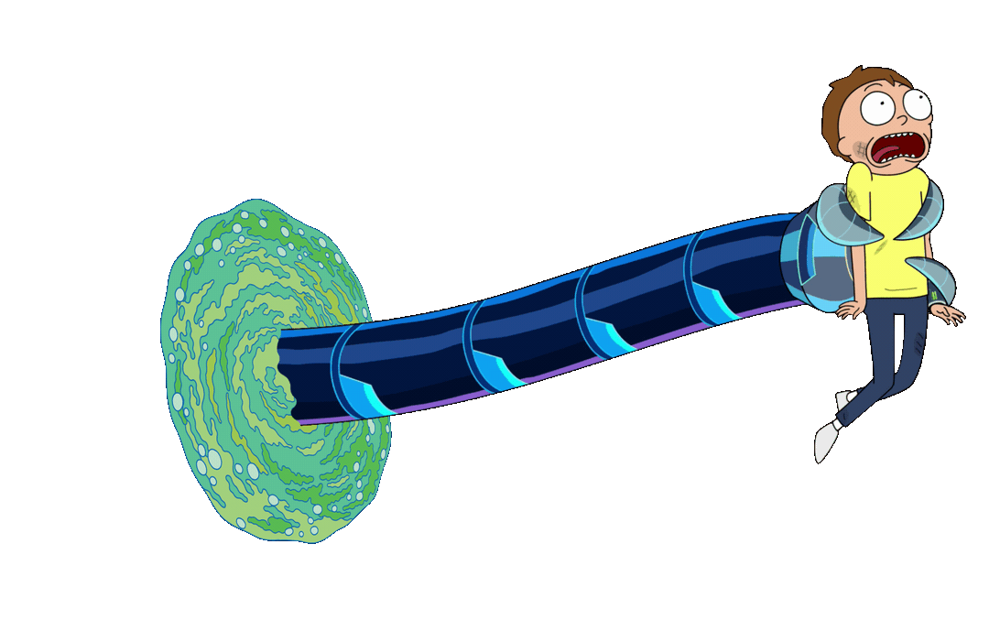
Thank you!
Back
Next

Slide 9
Github Repo: https://github.com/goheesheng/PentaAI
Back
Next

